Slide 1
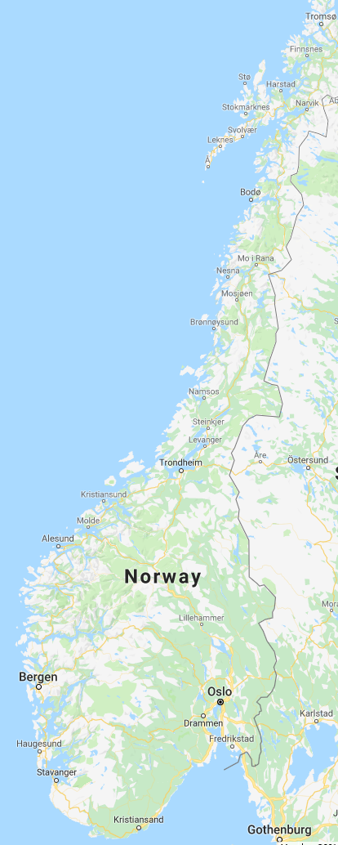
5
Andøya Island
Lofoten Islands
6
Arctic Circle
Sognefjord
2
1
Oslo
Bergen
3
Solstrand
4

Slide 2
Our Norway experience had so much variety and adventures. This web page is divided out into the 6 regions and towns that we visited, in the order shown on the map:
1- Oslo – the capital city, known for its green spaces and museums; 3 days.
2- Sognefjord – nicknamed the King of the Fjords, is the largest and deepest fjord in Norway; 2 days
3- Bergen -- known as the 'city of seven mountains' and was a Hanseatic trading post during the 13th to 18th centuries ; 3 days
4- Solstrand – a resort and spa just South of Bergen on the Bjørnafjorden fjord; 2 days
5- Andøya Island – 200 miles N. of the Arctic Circle, where my grandparents grew up; 2 days
6- Lofoten Islands – an archipelago of 6+ islands known for dramatic scenery mountains and arctic of fjords; 3 days
Recommended website for planning your trip: https://www.visitnorway.com/
Oslo, the capital of Norway, sits on the country’s southern coast at the head of the Oslofjord. It’s known for its green spaces and museums. Many of these are on the Bygdøy Peninsula, including the waterside Norwegian Maritime Museum and the Viking Ship Museum, with Viking ships from the 9th century

